Slide 1
Exploring Maximal r-Partite Hypergraphs using Generative Algorithms
Anna Dodson
Computer Science Honors Thesis
Advised by Prof. Deeparnab Chakrabarty

Slide 2
Computer Science Thesis
Open framework of exploration
Narrowing down a topic of interest
Graph theory + algorithms

Slide 3
Computer Science Thesis
Open framework of exploration
Narrowing down a topic of interest
Graph theory + algorithms

Slide 4
Computer Science Thesis
Open framework of exploration
Narrowing down a topic of interest
Graph theory + algorithms

Slide 5
Computer Science Thesis
Open framework of exploration
Narrowing down a topic of interest
Graph theory + algorithms
Ryser’s Conjecture for r-Partite Hypergraphs

Slide 6
Graph Theory Primer
A graph (or hypergraph) G = (V,E) is a set of vertices, V, and edges, E.
A vertex is a node in the graph, and an hyperedge can be considered a subset of vertices.
A vertex cover C of a graph is a set of vertices st all edges in the graph include at least one vertex ∈ C.
A matching M is a selection of hyperedges such that no two have any vertex in common.

Slide 7
Graph Theory Primer
A graph (or hypergraph) G = (V,E) is a set of vertices, V, and edges, E.
A vertex is a node in the graph, and an hyperedge can be considered a subset of vertices.
A vertex cover C of a graph is a set of vertices st all edges in the graph include at least one vertex ∈ C.
A matching M is a selection of hyperedges such that no two have any vertex in common.

Slide 8
Graph Theory Primer
A graph (or hypergraph) G = (V,E) is a set of vertices, V, and edges, E.
A vertex is a node in the graph, and an hyperedge can be considered a subset of vertices.
A vertex cover C of a graph is a set of vertices st all edges in the graph include at least one vertex ∈ C.
A matching M is a selection of hyperedges such that no two have any vertex in common.

Slide 9
Graph Theory Primer
A graph (or hypergraph) G = (V,E) is a set of vertices, V, and edges, E.
A vertex is a node in the graph, and an hyperedge can be considered a subset of vertices.
A vertex cover C of a graph is a set of vertices st all edges in the graph include at least one vertex ∈ C.
A matching M is a selection of hyperedges such that no two have any vertex in common.

Slide 10
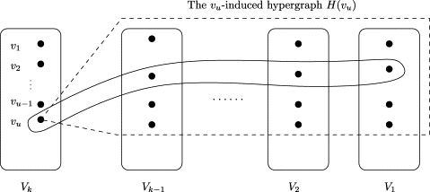

Graph Theory Primer
An r-partite r-uniform hypergraph is a hypergraph with r parts $V_{1}…V_{r}$ such that every edge e ∈ E contains exactly one element from every part $V_{i}.$

Slide 11

Ryser’s Conjecture for r-Partite Hypergraphs
In an r-partite r-uniform hypergraph, let the maximum matching be denoted $M.$ Let the minimum vertex cover be $C$.

Slide 12

Ryser’s Conjecture for r-Partite Hypergraphs
In an r-partite r-uniform hypergraph, let the maximum matching be denoted $M.$ Let the minimum vertex cover be $C$.
$$\left|C\right|≤\left(r−1\right)|M|$$
Ryser’s Conjecture for r-Partite Hypergraphs

Slide 13

Ryser’s Conjecture for r-Partite Hypergraphs
In an r-partite r-uniform hypergraph, let the maximum matching be denoted $M.$ Let the minimum vertex cover be $C$.
Hall’s Theorem is the bipartite case; Aharoni (2001) proves the case for tripartite hypergraphs. Can we extend to r-partite hypergraphs?
$$\left|C\right|≤\left(r−1\right)|M|$$
Ryser’s Conjecture for r-Partite Hypergraphs

Slide 14

Approach
Narrowing the problem – many open questions
Ryser’s Conjecture
$$\left|C\right|≤\left(r−1\right)|M|$$
r-partite hypergraph

Slide 15
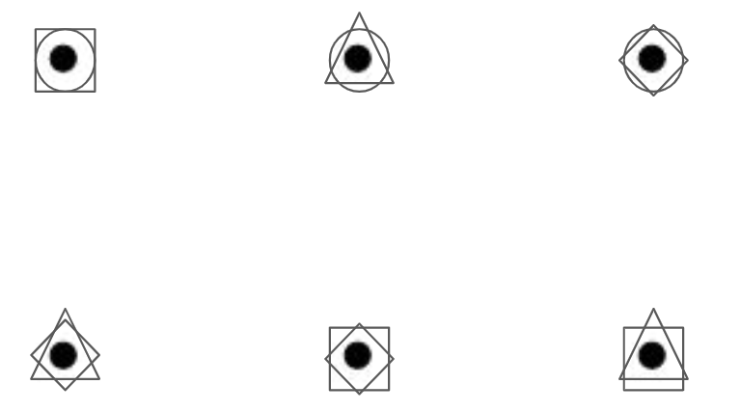
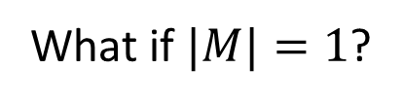
Approach
Narrowing the problem – many open questions
Ryser’s Conjecture
What if $|M|=1$?
$$\left|C\right|≤\left(r−1\right)|M|$$
r-partite hypergraph
Linear hypergraph

Slide 16
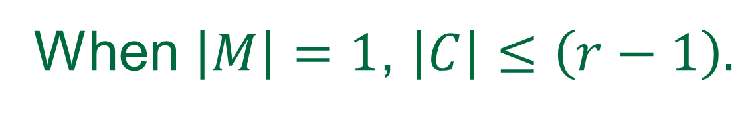
What if |M|=1? (Maximal Matching 1)
Can we generate some algorithm for a vertex cover with (r-1) vertices?
How do we prove the efficacy of such an algorithm?
When $\left|M\right|=1$, $\left|C\right|≤\left(r−1\right).$

Slide 17
What if |M|=1? (Maximal Matching 1)
Can we generate some algorithm for a vertex cover with (r-1) vertices?
How do we prove the efficacy of such an algorithm?
When $\left|M\right|=1$, $\left|C\right|≤\left(r−1\right).$

Slide 18
What if |M|=1? (Maximal Matching 1)
Can we generate some algorithm for a vertex cover with (r-1) vertices?
How do we prove the efficacy of such an algorithm?
When $\left|M\right|=1$, $\left|C\right|≤\left(r−1\right).$

Slide 19
The Alice-Bob Game

Slide 20
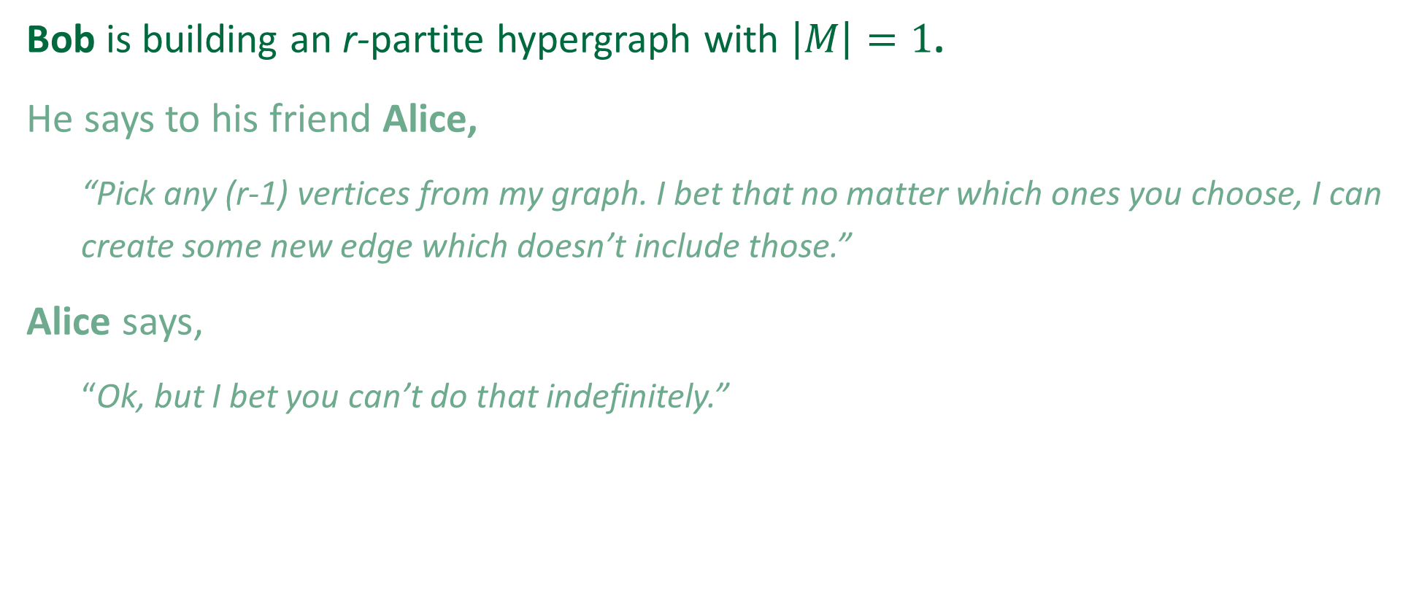
The Alice-Bob Game
Bob is building an r-partite hypergraph with $\left|M\right|=1$.
He says to his friend Alice,
“Pick any (r-1) vertices from my graph. I bet that no matter which ones you choose, I can create some new edge which doesn’t include those.”
Alice says,
“Ok, but I bet you can’t do that indefinitely.”

Slide 21
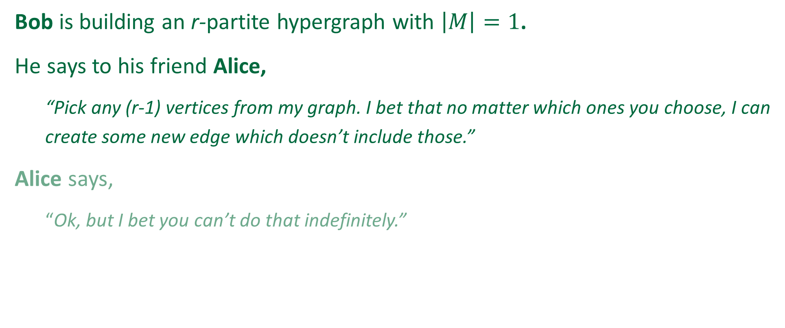
The Alice-Bob Game
Bob is building an r-partite hypergraph with $\left|M\right|=1$.
He says to his friend Alice,
“Pick any (r-1) vertices from my graph. I bet that no matter which ones you choose, I can create some new edge which doesn’t include those.”
Alice says,
“Ok, but I bet you can’t do that indefinitely.”

Slide 22
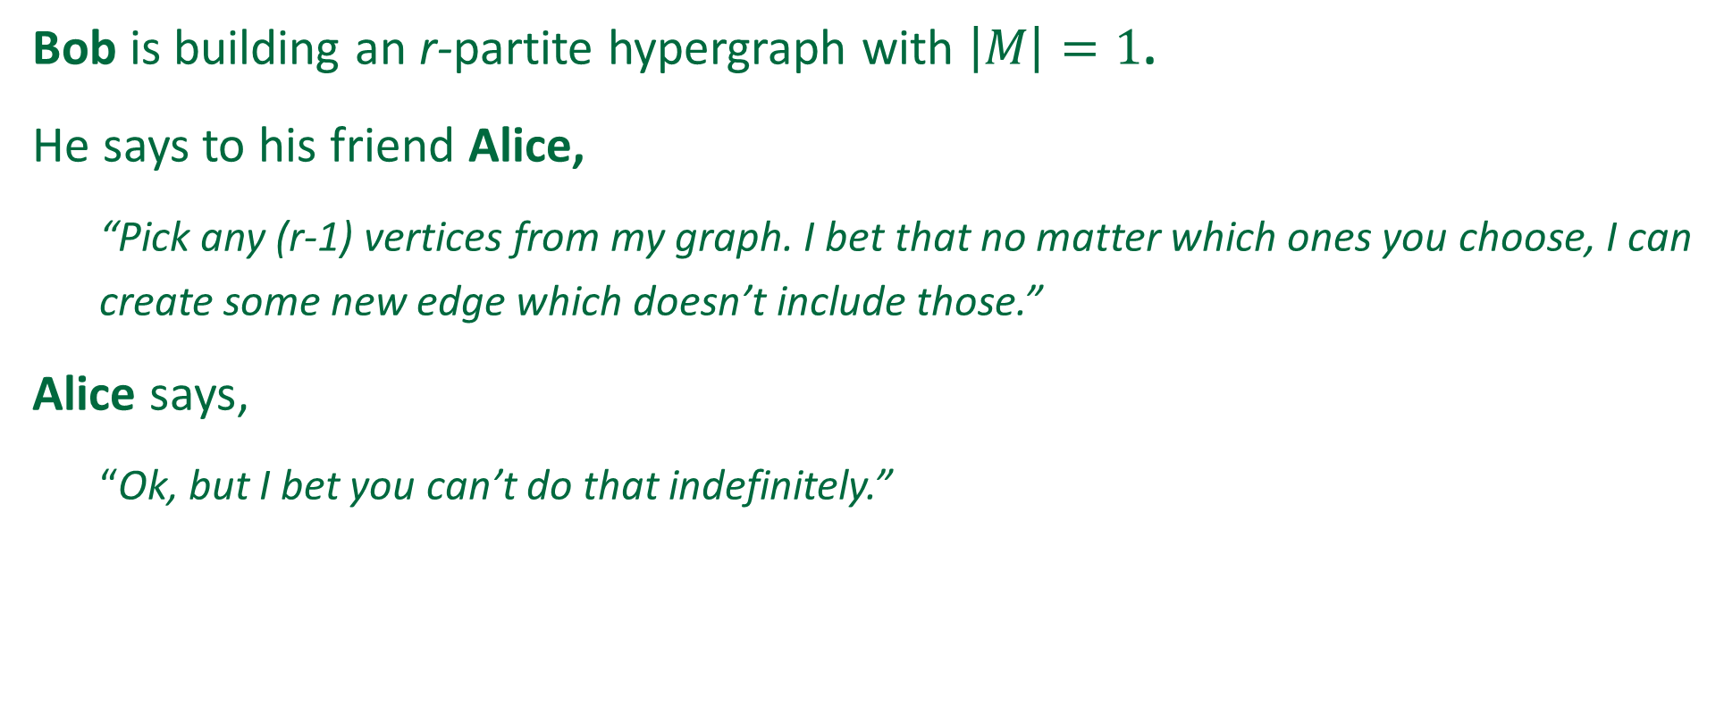
The Alice-Bob Game
Bob is building an r-partite hypergraph with $\left|M\right|=1$.
He says to his friend Alice,
“Pick any (r-1) vertices from my graph. I bet that no matter which ones you choose, I can create some new edge which doesn’t include those.”
Alice says,
“Ok, but I bet you can’t do that indefinitely.”

Slide 23
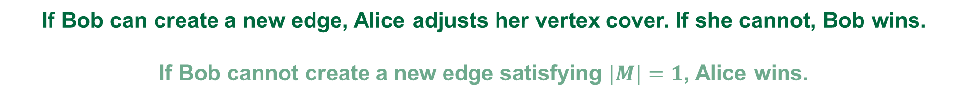
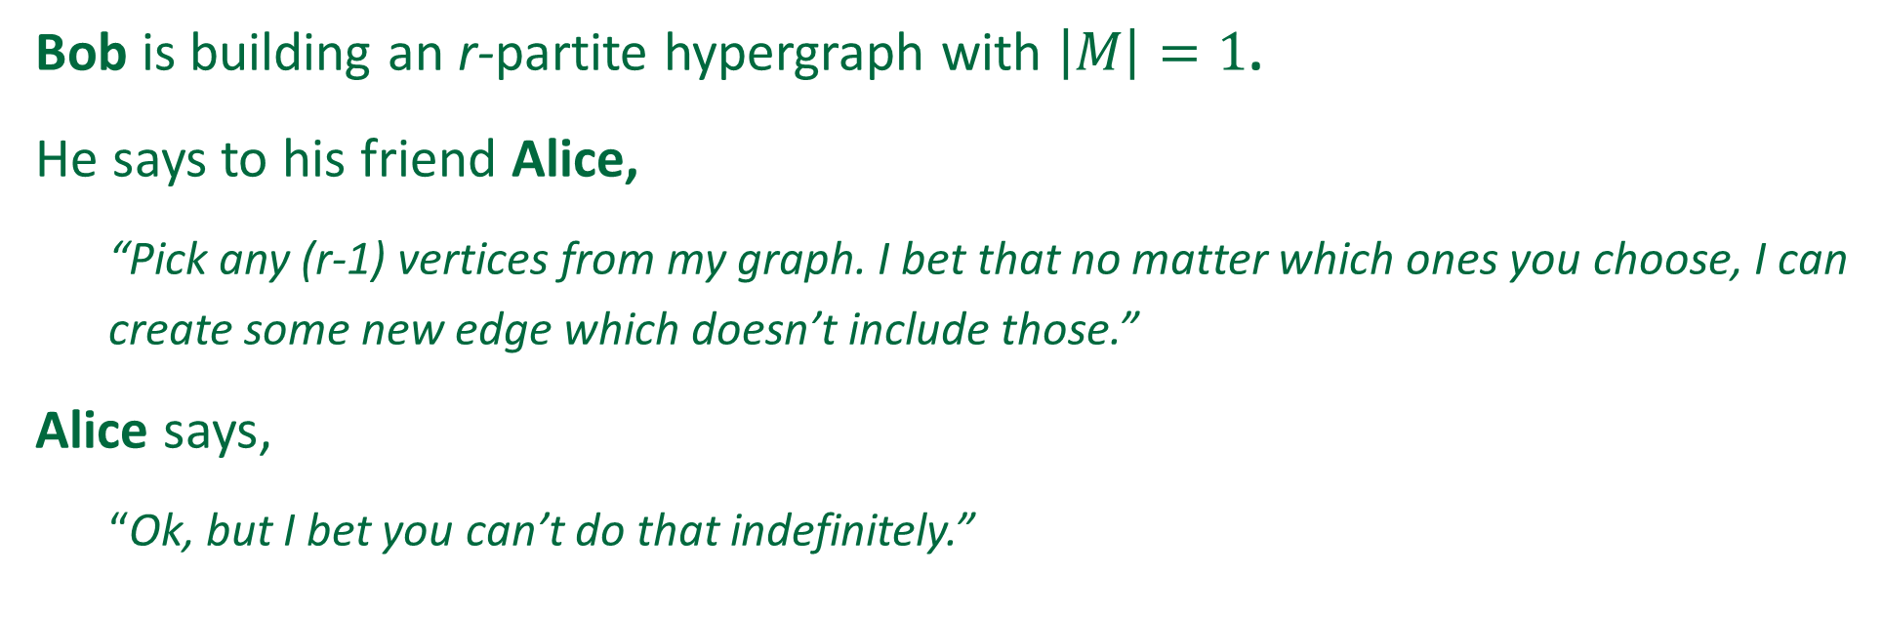
The Alice-Bob Game
Bob is building an r-partite hypergraph with $\left|M\right|=1$.
He says to his friend Alice,
“Pick any (r-1) vertices from my graph. I bet that no matter which ones you choose, I can create some new edge which doesn’t include those.”
Alice says,
“Ok, but I bet you can’t do that indefinitely.”
If Bob can create a new edge, Alice adjusts her vertex cover. If she cannot, Bob wins.
If Bob cannot create a new edge satisfying $|M|=1$, Alice wins.

Slide 24
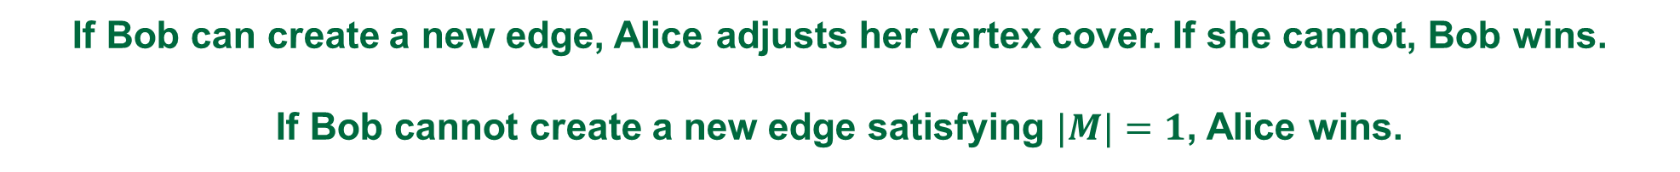
The Alice-Bob Game
Bob is building an r-partite hypergraph with $\left|M\right|=1$.
He says to his friend Alice,
“Pick any (r-1) vertices from my graph. I bet that no matter which ones you choose, I can create some new edge which doesn’t include those.”
Alice says,
“Ok, but I bet you can’t do that indefinitely.”
If Bob can create a new edge, Alice adjusts her vertex cover. If she cannot, Bob wins.
If Bob cannot create a new edge satisfying $|M|=1$, Alice wins.

Slide 25

The Alice-Bob Reactive Graph
Play arbitrary
[$v_{11}….v_{r1}$]
to initialize the graph

Slide 26
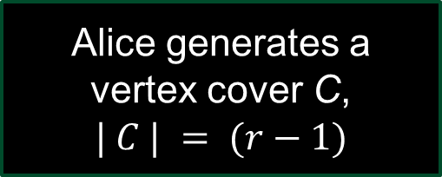
The Alice-Bob Reactive Graph
Play arbitrary
[$v_{11}….v_{r1}$]
to initialize the graph
Alice generates a vertex cover C,
$$| C | = (r−1)$$

Slide 27
The Alice-Bob Reactive Graph
Play arbitrary
[$v_{11}….v_{r1}$]
to initialize the graph
Does C cover all edges?
Alice generates a vertex cover C,
$$| C | = (r−1)$$

Slide 28
The Alice-Bob Reactive Graph
Play arbitrary
[$v_{11}….v_{r1}$]
to initialize the graph
Alice needs a new algorithm
No
Does C cover all edges?
Alice generates a vertex cover C,
$$| C | = (r−1)$$

Slide 29

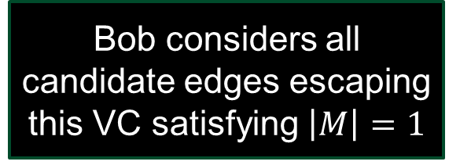
The Alice-Bob Reactive Graph
Play arbitrary
[$v_{11}….v_{r1}$]
to initialize the graph
Alice needs a new algorithm
No
Does C cover all edges?
Alice generates a vertex cover C,
$$| C | = (r−1)$$
Yes
[$v_{1x}….v_{rx}$]
Bob considers all candidate edges escaping this VC satisfying $\left|M\right|=1$

Slide 30
The Alice-Bob Reactive Graph
Play arbitrary
[$v_{11}….v_{r1}$]
to initialize the graph
Alice needs a new algorithm
No
Does C cover all edges?
Alice generates a vertex cover C,
$$| C | = (r−1)$$
Yes
[$v_{1x}….v_{rx}$]
Bob considers all candidate edges escaping this VC satisfying $\left|M\right|=1$
Is the set empty?

Slide 31
The Alice-Bob Reactive Graph
Play arbitrary
[$v_{11}….v_{r1}$]
to initialize the graph
Alice needs a new algorithm
No
Does C cover all edges?
Alice generates a vertex cover C,
$$| C | = (r−1)$$
Bob adds edge to the graph**
Yes
No
[$v_{1x}….v_{rx}$]
Bob considers all candidate edges escaping this VC satisfying $\left|M\right|=1$
Is the set empty?
Game terminates
Yes

Slide 32
The Alice-Bob Reactive Graph
**How to determine optimal edge?
Play arbitrary
[$v_{11}….v_{r1}$]
to initialize the graph
Alice needs a new algorithm
No
Does C cover all edges?
Alice generates a vertex cover C,
$$| C | = (r−1)$$
Bob adds edge to the graph**
Yes
No
[$v_{1x}….v_{rx}$]
Bob considers all candidate edges escaping this VC satisfying $\left|M\right|=1$
Is the set empty?
Game terminates
Yes

Slide 33

Bob’s Reaction
I. Brute-force edge generation
# of hypergraphs increases exponentially in r.
Terminates for r=3 and r=4
II. Optimal edge(s) generation
III. Further constraints on hypergraph

Slide 34
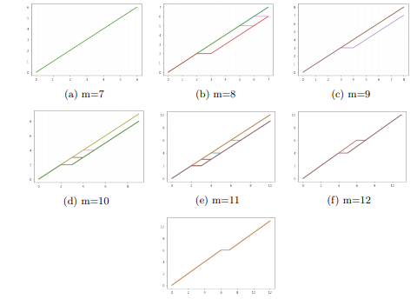
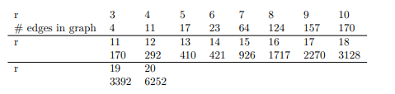
Bob’s Reaction
I. Brute-force edge generation
# of hypergraphs increases exponentially in r.
Terminates for r=3 and r=4
II. Optimal edge(s) generation
III. Further constraints on hypergraph

Slide 35
Bob’s Reaction
I. Brute-force edge generation
# of hypergraphs increases exponentially in r.
Terminates for r=3 and r=4
II. Optimal edge(s) generation
III. Further constraints on hypergraph

Slide 36
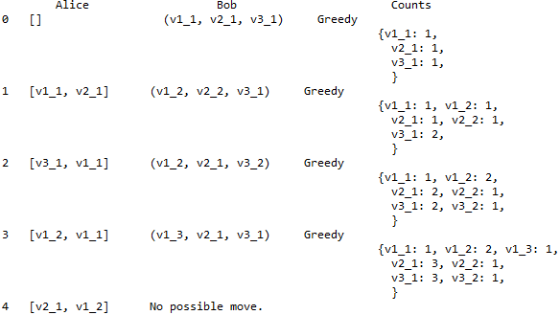
Sample Transcript, $r=3$

Slide 37

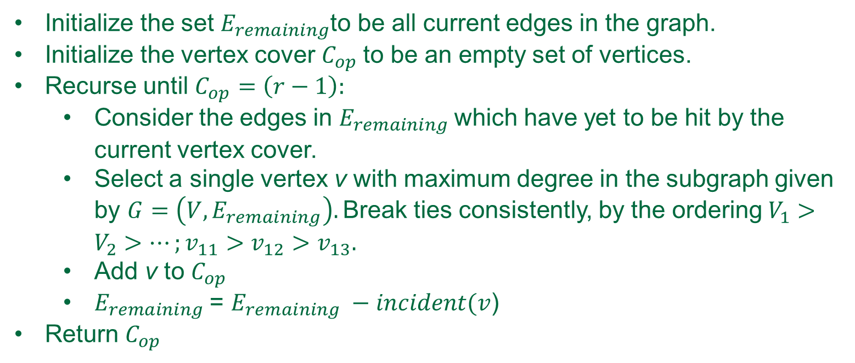
Alice’s Algorithm (empirically validated)
Initialize the set $E_{remaining}$to be all current edges in the graph.
Initialize the vertex cover $C_{op}$to be an empty set of vertices.
Recurse until $C_{op}=\left(r−1\right):$
Consider the edges in $E_{remaining}$which have yet to be hit by the current vertex cover.
Select a single vertex v with maximum degree in the subgraph given by $G=\left(V, E_{remaining}\right).$Break ties consistently, by the ordering $V_{1}>V_{2}>…;v_{11}>v_{12}>v_{13}.$
Add v to $C_{op}$
$E_{remaining}$= $E_{remaining} −incident(v$)
Return $C_{op}$
NP-complete $O(V+E)$time

Slide 38
Return: Narrowing down the problem
Ryser’s Conjecture
What if $|M|=1$?
$$\left|C\right|≤\left(r−1\right)|M|$$
r-partite hypergraph
Linear hypergraph

Slide 39
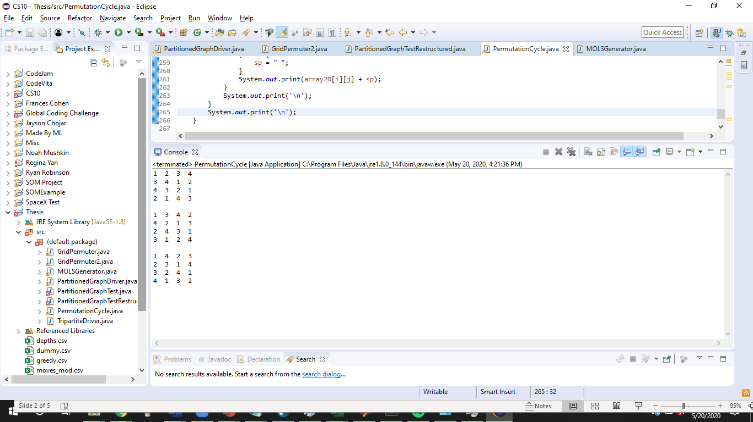
Return: Narrowing down the problem
Ryser’s Conjecture
What if $|M|=1$?
What if k = 1?
$$\left|C\right|≤\left(r−1\right)|M|$$
r-partite hypergraph
Linear hypergraph
Linear 1-intersecting hypergraph

Slide 40
Linear 1-intersecting hypergraphs
All edges intersect all other edges exactly once.
What is the maximum size of the hypergraph?
How do we generate maximum-sized hypergraphs?

Slide 41
Linear 1-intersecting hypergraphs
All edges intersect all other edges exactly once.
What is the maximum size of the hypergraph?
How do we generate maximum-sized hypergraphs?

Slide 42
Linear 1-intersecting hypergraphs
All edges intersect all other edges exactly once.
What is the maximum size of the hypergraph?
Maximum number of edges?
How do we generate maximum-sized hypergraphs?

Slide 43
Linear 1-intersecting hypergraphs
All edges intersect all other edges exactly once.
What is the maximum size of the hypergraph?
Maximum number of edges?
Maximum number of vertices?
How do we generate maximum-sized hypergraphs?

Slide 44
Linear 1-intersecting hypergraphs
All edges intersect all other edges exactly once.
What is the maximum size of the hypergraph?
Maximum number of edges?
Maximum number of vertices?
Maximum size of a part?
How do we generate maximum-sized hypergraphs?

Slide 45
Linear 1-intersecting hypergraphs
All edges intersect all other edges exactly once.
What is the maximum size of the hypergraph?
Maximum number of edges?
Maximum number of vertices?
Maximum size of a part?
Other bounds we can define?
How do we generate maximum-sized hypergraphs?

Slide 46
Linear 1-intersecting hypergraphs
All edges intersect all other edges exactly once.
What is the maximum size of the hypergraph?
Maximum number of edges?
Maximum number of vertices?
Maximum size of a part?
Other bounds we can define?
How do we generate maximum-sized hypergraphs?

Slide 47
Maximum size of the hypergraph
Drumroll, please…

Slide 48

Maximum size of the hypergraph
Drumroll, please…

Slide 49






Maximum size of the hypergraph
We could play infinitely with the intersection in a single vertex, $v_{11}$.
What if $\left|C\right|≥2?$
$$V_{1}$$
$$V_{2}$$
…
$$V_{5}=V_{r}$$
$$v_{11}$$
…

Slide 50
Maximum size of the hypergraph
We could play infinitely with the intersection in a single vertex, $v_{11}$.
What if $\left|C\right|≥2?$
$$V_{1}$$
$$V_{2}$$
…
$$V_{5}=V_{r}$$
$$v_{11}$$
…

Slide 51
Maximum size of the hypergraph
We could play infinitely with the intersection in a single vertex, $v_{11}$.
What if $\left|C\right|≥2?$
$$V_{1}$$
$$V_{2}$$
…
$$V_{5}=V_{r}$$
$$v_{11}$$
…

Slide 52
Maximum size of the hypergraph
We could play infinitely with the intersection in a single vertex, $v_{11}$.
What if $\left|C\right|≥2?$
$$V_{1}$$
$$V_{2}$$
…
$$V_{5}=V_{r}$$
$$v_{11}$$
…

Slide 53
Maximum size of the hypergraph
We could play infinitely with the intersection in a single vertex, $v_{11}$.
What if $\left|C\right|≥2?$
$$V_{1}$$
$$V_{2}$$
…
$$V_{5}=V_{r}$$
$$v_{11}$$
…

Slide 54
Maximum size of the hypergraph
We could play infinitely with the intersection in a single vertex, $v_{11}$.
What if $\left|C\right|≥2?$
$$V_{1}$$
$$V_{2}$$
…
$$V_{5}=V_{r}$$
$$v_{11}$$
…

Slide 55
Maximum size of the hypergraph
We could play infinitely with the intersection in a single vertex, $v_{11}$.
What if $\left|C\right|≥2?$
$$V_{1}$$
$$V_{2}$$
…
$$V_{5}=V_{r}$$
$$v_{11}$$
…

Slide 56

Maximum size of the hypergraph
We could play infinitely with the intersection in a single vertex, $v_{11}$.
What if $\left|C\right|≥2?$
$$V_{1}$$
$$V_{2}$$
…
$$V_{5}=V_{r}$$
$$v_{11}$$
…

Slide 57

Maximum size of the hypergraph
We could play infinitely with the intersection in a single vertex, $v_{11}$.
What if $\left|C\right|≥2?$
Then:
$\left|V_{i}\right|≥2$
$\max\left(d_{v}\right)=\left(r−1\right)$
$$V_{1}$$
$$V_{2}$$
…
$$V_{5}=V_{r}$$
$$v_{11}$$
…

Slide 58

Maximum size of the hypergraph
We could play infinitely with the intersection in a single vertex, $v_{11}$.
What if $\left|C\right|≥2?$
Then:
$\left|V_{i}\right|≥2$
$\max\left(d_{v}\right)=\left(r−1\right)$
$$V_{1}$$
$$V_{2}$$
…
$$V_{5}=V_{r}$$
$$v_{11}$$
…

Slide 59

Maximum size of the hypergraph
We could play infinitely with the intersection in a single vertex, $v_{11}$.
What if $\left|C\right|≥2?$
Then:
$\left|V_{i}\right|≥2$
$\max\left(d_{v}\right)=\left(r−1\right)$
$$V_{1}$$
$$V_{2}$$
…
$$V_{5}=V_{r}$$
$$v_{11}$$
$$v_{12}$$
…

Slide 60

Maximum size of the hypergraph
We could play infinitely with the intersection in a single vertex, $v_{11}$.
What if $\left|C\right|≥2?$
Then:
$\left|V_{i}\right|≥2$
$\max\left(d_{v}\right)=\left(r−1\right)$
$$V_{1}$$
$$V_{2}$$
…
$$V_{5}=V_{r}$$
$$v_{11}$$
$$v_{12}$$
…

Slide 61
Maximum size of the hypergraph
We could play infinitely with the intersection in a single vertex, $v_{11}$.
What if $\left|C\right|≥2?$
Then:
$\left|V_{i}\right|≥2$
$\max\left(d_{v}\right)=\left(r−1\right)$
$$V_{1}$$
$$V_{2}$$
…
$$V_{5}=V_{r}$$
$$v_{11}$$
$$v_{12}$$
…

Slide 62
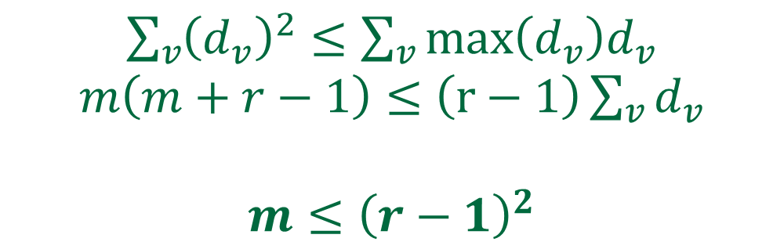

Bound on the number of edges
2 ways of counting:
Linear + intersecting = every edge intersects every other edge once
$\sum_{v}{\left(\begin{matrix}ⅆ_{v} \\ 2\end{matrix}\right)=\left(\begin{matrix}m \\ 2\end{matrix}\right)}$ $\sum_{v}{{\left(d_{v}\right)}^{2}−\sum_{v}{d_{v}}=m\left(m−1\right)}$
Handshake Lemma
$\sum_{v}{d_{v}}=rm$
$\sum_{v}{{\left(d_{v}\right)}^{2}≤}$ $\sum_{v}{{max\left(d_{v}\right)d}_{v}}$
$m\left(m+r−1\right)≤$ $\left(r−1\right)\sum_{v}{d_{v}}$
$$m≤{\left(r−1\right)}^{2}$$

Slide 63




Maximum size of the hypergraph
$$V_{1}$$
$$V_{2}$$
…
$$V_{5}$$
$$v_{11}$$

Slide 64
Maximum size of the hypergraph
$$V_{1}$$
$$V_{2}$$
…
$$V_{5}$$
[ 1 1 1 1 ]
[ 2 2 2 2 ]
[ 3 3 3 3 ]
[ 4 4 4 4 ]
$$v_{11}$$

Slide 65

Maximum size of the hypergraph
$$V_{1}$$
$$V_{2}$$
…
$$V_{5}$$
[ 1 1 1 1 ]
[ 2 2 2 2 ]
[ 3 3 3 3 ]
[ 4 4 4 4 ]
$$v_{11}$$
$$v_{12}$$

Slide 66
Maximum size of the hypergraph
$$V_{1}$$
$$V_{2}$$
…
$$V_{5}$$
[ 1 1 1 1 ]
[ 2 2 2 2 ]
[ 3 3 3 3 ]
[ 4 4 4 4 ]
[ 1 2 3 4 ]
$$v_{11}$$
$$v_{12}$$

Slide 67
Maximum size of the hypergraph
$$V_{1}$$
$$V_{2}$$
…
$$V_{5}$$
[ 1 1 1 1 ]
[ 2 2 2 2 ]
[ 3 3 3 3 ]
[ 4 4 4 4 ]
[ 1 2 3 4 ]
[ 3 4 1 2 ]
$$v_{11}$$
$$v_{12}$$

Slide 68
Maximum size of the hypergraph
$$V_{1}$$
$$V_{2}$$
…
$$V_{5}$$
[ 1 1 1 1 ]
[ 2 2 2 2 ]
[ 3 3 3 3 ]
[ 4 4 4 4 ]
[ 1 2 3 4 ]
[ 3 4 1 2 ]
[ 2 1 4 3 ]
[ 4 3 2 1 ]
$$v_{11}$$
$$v_{12}$$

Slide 69
Maximum size of the hypergraph
$$V_{1}$$
$$V_{2}$$
…
$$V_{5}$$
[ 1 1 1 1 ]
[ 2 2 2 2 ]
[ 3 3 3 3 ]
[ 4 4 4 4 ]
[ 1 2 3 4 ]
[ 3 4 1 2 ]
[ 2 1 4 3 ]
[ 4 3 2 1 ]
$$v_{11}$$
$$v_{12}$$
Can we play (r-1) of these “bundles” of edges?

Slide 70
Latin Squares
A Latin square is an n × n matrix in which n distinct symbols from a symbol set S are arranged, such that each symbol occurs exactly once in each row and in each column.
A reduced form Latin square is Latin square in which the first row is in the natural order of the symbol set we chose.

Slide 71
Latin Squares
A Latin square is an n × n matrix in which n distinct symbols from a symbol set S are arranged, such that each symbol occurs exactly once in each row and in each column.
A reduced form Latin square is Latin square in which the first row is in the natural order of the symbol set we chose.
[ 1 2 3 4 ]
[ 3 4 1 2 ]
[ 2 1 4 3 ]
[ 4 3 2 1 ]

Slide 72
Latin Squares
A Latin square is an n × n matrix in which n distinct symbols from a symbol set S are arranged, such that each symbol occurs exactly once in each row and in each column.
A reduced form Latin square is Latin square in which the first row is in the natural order of the symbol set we chose.
[ 1 2 3 4 ]
[ 3 4 1 2 ]
[ 2 1 4 3 ]
[ 4 3 2 1 ]
[ 1 2 3 4 ]

Slide 73

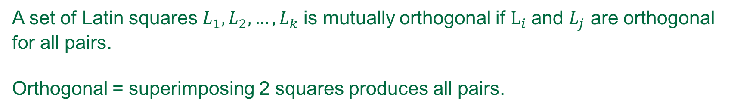
Mutually orthogonal Latin squares (MOLS)
A set of Latin squares $L_{1}, L_{2},…,L_{k}$is mutually orthogonal if $L_{i}$and $L_{j}$ are orthogonal for all pairs.
Orthogonal = superimposing 2 squares produces all pairs.
1 | 2 | 3 | 4
2 | 1 | 4 | 3
3 | 4 | 1 | 2
4 | 3 | 2 | 1
1 | 2 | 3 | 4
3 | 4 | 1 | 2
4 | 3 | 2 | 1
2 | 1 | 4 | 3
11 | 22 | 33 | 44
23 | 41 | 14 | 23
34 | 43 | 12 | 21
42 | 31 | 24 | 13
$$→$$

Slide 74
Mutually orthogonal Latin squares (MOLS)
A set of Latin squares $L_{1}, L_{2},…,L_{k}$is mutually orthogonal if $L_{i}$and $L_{j}$ are orthogonal for all pairs.
Orthogonal = superimposing 2 squares produces all pairs.
1 | 2 | 3 | 4
2 | 1 | 4 | 3
3 | 4 | 1 | 2
4 | 3 | 2 | 1
1 | 2 | 3 | 4
3 | 4 | 1 | 2
4 | 3 | 2 | 1
2 | 1 | 4 | 3
11 | 22 | 33 | 44
23 | 41 | 14 | 23
34 | 43 | 12 | 21
42 | 31 | 24 | 13
$$→$$
Reduced orthogonal squares share exactly one row.
We would like 2 bundles to share one element per row.

Slide 75

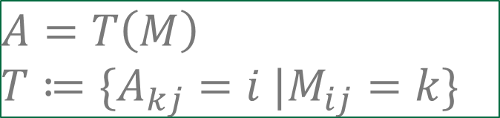

Construction of 1-intersecting bundles
We would like 2 bundles to share one element per row.
2 reduced form MOLS share exactly one row.
Solution: transform the elements
$$M_{1}$$
$$M_{2}$$
1 | 2 | 3 | 4
2 | 1 | 4 | 3
3 | 4 | 1 | 2
4 | 3 | 2 | 1
1 | 2 | 3 | 4
3 | 4 | 1 | 2
4 | 3 | 2 | 1
2 | 1 | 4 | 3
$$A=T\left(M\right)$$
$$T≔\{A_{kj}=i |M_{ij}=k\}$$

Slide 76


Construction of 1-intersecting bundles
We would like 2 bundles to share one element per row.
2 reduced form MOLS share exactly one row.
Solution: transform the elements
$$M_{1}$$
$$M_{2}$$
1 | 2 | 3 | 4
2 | 1 | 4 | 3
3 | 4 | 1 | 2
4 | 3 | 2 | 1
1 | 2 | 3 | 4
3 | 4 | 1 | 2
4 | 3 | 2 | 1
2 | 1 | 4 | 3
$$A=T\left(M\right)$$
$$T≔\{A_{kj}=i |M_{ij}=k\}$$
$$A_{1}$$
$$A_{2}$$
1 | 2 | 3 | 4
2 | 1 | 4 | 3
3 | 4 | 1 | 2
4 | 3 | 2 | 1
1 | 4 | 2 | 3
4 | 1 | 3 | 2
2 | 3 | 1 | 4
3 | 2 | 4 | 1

Slide 77
Construction of 1-intersecting bundles
We would like 2 bundles to share one element per row.
2 reduced form MOLS share exactly one row.
Solution: transform the elements
$$M_{1}$$
$$M_{2}$$
1 | 2 | 3 | 4
2 | 1 | 4 | 3
3 | 4 | 1 | 2
4 | 3 | 2 | 1
1 | 2 | 3 | 4
3 | 4 | 1 | 2
4 | 3 | 2 | 1
2 | 1 | 4 | 3
$$A=T\left(M\right)$$
$$T≔\{A_{kj}=i |M_{ij}=k\}$$
$$A_{1}$$
$$A_{2}$$
1 | 2 | 3 | 4
2 | 1 | 4 | 3
3 | 4 | 1 | 2
4 | 3 | 2 | 1
1 | 4 | 2 | 3
4 | 1 | 3 | 2
2 | 3 | 1 | 4
3 | 2 | 4 | 1
Note: if M in reduced form, all 1’s on diagonal

Slide 78
Maximum size of the hypergraph
$$V_{1}$$
$$V_{2}$$
…
$$V_{5}$$
[ 1 1 1 1 ]
[ 2 2 2 2 ]
[ 3 3 3 3 ]
[ 4 4 4 4 ]
[ 1 2 3 4 ]
[ 3 4 1 2 ]
[ 2 1 4 3 ]
[ 4 3 2 1 ]
$$v_{11}$$
$$v_{12}$$
Can we play (r-1) of these “bundles” of edges?

Slide 79





Maximum size of the hypergraph
$$V_{1}$$
$$V_{2}$$
…
$$V_{5}$$
[ 1 1 1 1 ]
[ 2 2 2 2 ]
[ 3 3 3 3 ]
[ 4 4 4 4 ]
[ 1 2 3 4 ]
[ 3 4 1 2 ]
[ 2 1 4 3 ]
[ 4 3 2 1 ]
$$v_{11}$$
$$v_{12}$$
Can we play (r-1) of these “bundles” of edges?
Can we play (r-2) MOLS?

Slide 80
Can we play (r-2)MOLS?
Theorem:
For a MOLS of order n, it is possible to generate (n-1)MOLS if and only if n is a prime power.
$$r−1=p^{d} → \left(r−2\right)MOLS$$

Slide 81
Generating (r-2) MOLS
In general, difficult to construct all sets of (r-2)MOLS
$$r−1=p^{d} → \left(r−2\right)MOLS$$

Slide 82
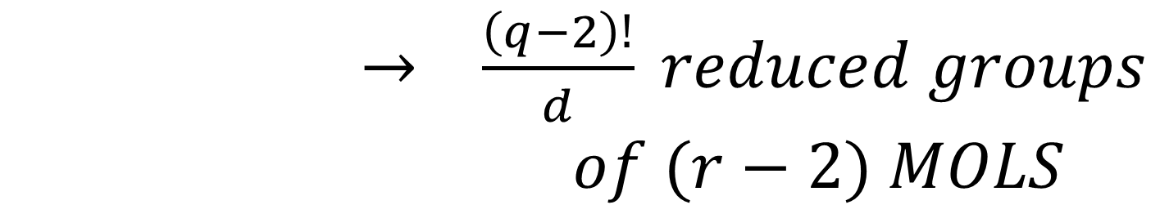
Generating (r-2) MOLS
In general, difficult to construct all sets of (r-2)MOLS
$$r−1=p^{d} → \left(r−2\right)MOLS$$
$→ \frac{\left(q−2\right)!}{d} reduced groups$
$$of (r−2) MOLS$$

Slide 83
Generating (r-2) MOLS
In general, difficult to construct all sets of (r-2)MOLS
$$r−1=p^{d} → \left(r−2\right)MOLS$$
$→ \frac{\left(q−2\right)!}{d} reduced groups$
$$of (r−2) MOLS$$
Finite Field Construction
Generalized Bose/ Mann Construction
Direct Product Construction

Slide 84
Generating (r-2) MOLS
In general, difficult to construct all sets of (r-2)MOLS
$$r−1=p^{d} → \left(r−2\right)MOLS$$
$→ \frac{\left(q−2\right)!}{d} reduced groups$
$$of (r−2) MOLS$$
Finite Field Construction
Generalized Bose/ Mann Construction
Direct Product Construction

Slide 85
Generating (r-2) MOLS
In general, difficult to construct all sets of (r-2)MOLS
$$r−1=p^{d} → \left(r−2\right)MOLS$$
$→ \frac{\left(q−2\right)!}{d} reduced groups$
$$of (r−2) MOLS$$
Finite Field Construction
Generalized Bose/ Mann Construction
Direct Product Construction

Slide 86
Generating (r-2) MOLS
In general, difficult to construct all sets of (r-2)MOLS
$$r−1=p^{d} → \left(r−2\right)MOLS$$
$→ \frac{\left(q−2\right)!}{d} reduced groups$
$$of (r−2) MOLS$$
Finite Field Construction
Generalized Bose/ Mann Construction
Direct Product Construction

Slide 87
Generating (r-2) MOLS
In general, difficult to construct all sets of (r-2)MOLS
$$r−1=p^{d} → \left(r−2\right)MOLS$$
$→ \frac{\left(q−2\right)!}{d} reduced groups$
$$of (r−2) MOLS$$
Finite Field Construction
Generalized Bose/ Mann Construction
Direct Product Construction
IV. My construction

Slide 88
Construction for (r-1) 1-intersecting bundles
1 2 3 4 5 6 7 8
5 6 7 8 1 2 3 4
7 8 5 6 3 4 1 2
3 4 1 2 7 8 5 6
4 3 2 1 8 7 6 5
8 7 6 5 4 3 2 1
6 5 8 7 2 1 4 3
2 1 4 3 6 5 8 7

Slide 89
Construction for (r-1) 1-intersecting bundles
1 2 3 4 5 6 7 8
5 6 7 8 1 2 3 4
7 8 5 6 3 4 1 2
3 4 1 2 7 8 5 6
4 3 2 1 8 7 6 5
8 7 6 5 4 3 2 1
6 5 8 7 2 1 4 3
2 1 4 3 6 5 8 7

Slide 90
Construction for (r-1) 1-intersecting bundles

Slide 91
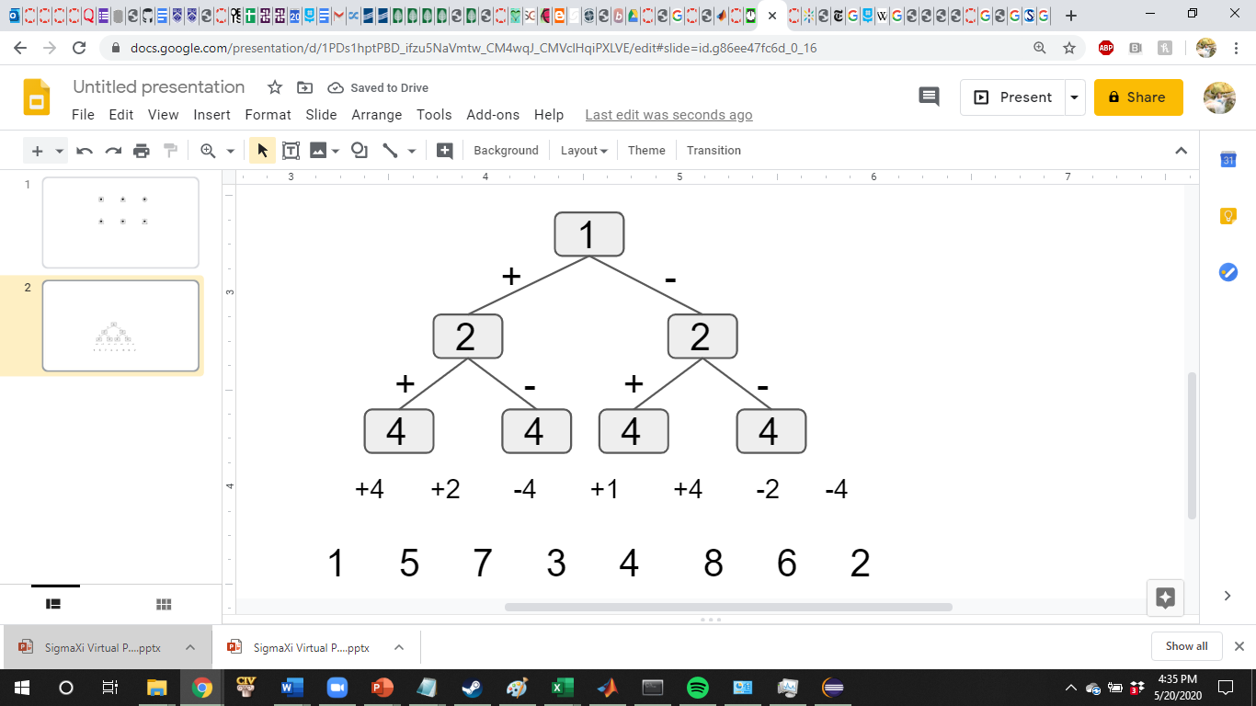
Construction for (r-1) 1-intersecting bundles

Slide 92

Construction for (r-1) 1-intersecting bundles
This generates the permutation matrix $Π$ and permutation σ.

Slide 93

Generating (r-1) 1-intersecting bundles from $Π, σ$
$$Π$$
σ
1 2 3 4 5 6 7 8
5 6 7 8 1 2 3 4
7 8 5 6 3 4 1 2
3 4 1 2 7 8 5 6
4 3 2 1 8 7 6 5
8 7 6 5 4 3 2 1
6 5 8 7 2 1 4 3
2 1 4 3 6 5 8 7

Slide 94
Generating (r-1) 1-intersecting bundles from $Π, σ$
σ contains 1 fixed element and a (r-2)-orbital
σ =

Slide 95
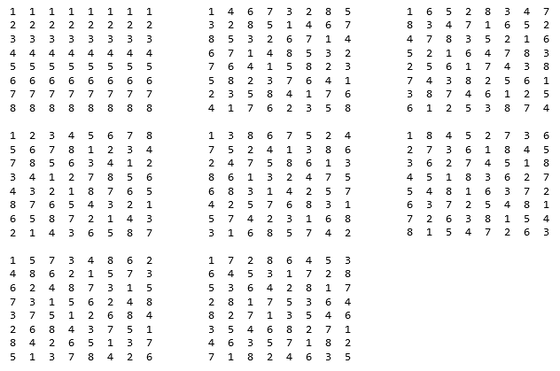
Generating (r-1) 1-intersecting bundles from $Π$
σ contains 1 fixed element and a (r-2)-orbital

Slide 96

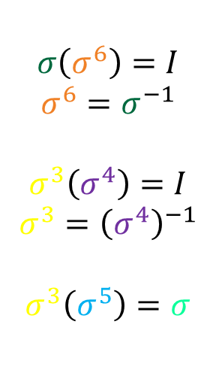
Generating (r-1) 1-intersecting bundles from $Π$
σ contains 1 fixed element and a (r-2)-orbital
$$\left\{I, σ, σ^{2}, σ^{3}, σ^{4},σ^{5}, σ^{6}\right\}$$
$$σ\left(σ^{6}\right)=I$$
$$σ^{6}=σ^{−1}$$
$$σ^{3}\left(σ^{4}\right)=I$$
$$σ^{3}={\left(σ^{4}\right)}^{−1}$$
$$σ^{3}\left(σ^{5}\right)=σ$$

Slide 97
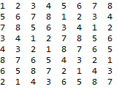
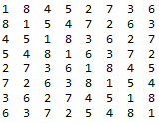
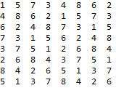
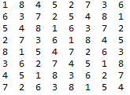
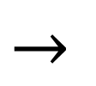
Problem: MOLS is not in reduced form
Bundle
MOLS
$$→$$

Slide 98
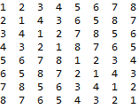
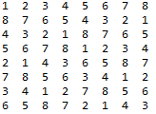

Solution: reassign symbols of identity MOLS
MOLS
Reduced form MOLS
$$→$$
We are applying$σ!$

Slide 99
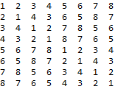
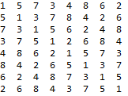
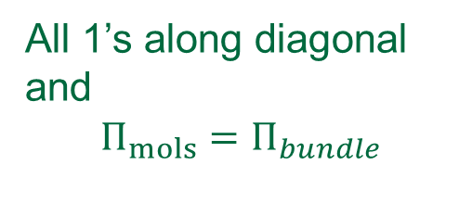
Recast to 1-intersecting bundle
Reduced form MOLS
Bundle
$$→$$
All 1’s along diagonal and
$$Π_{mols}=Π_{bundle}$$

Slide 100
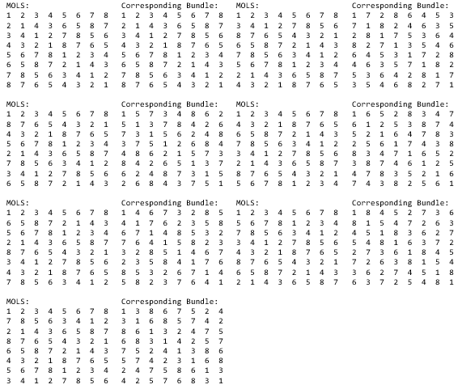
Generating (r-1) symmetric 1-intersecting bundles from $Π$

Slide 101
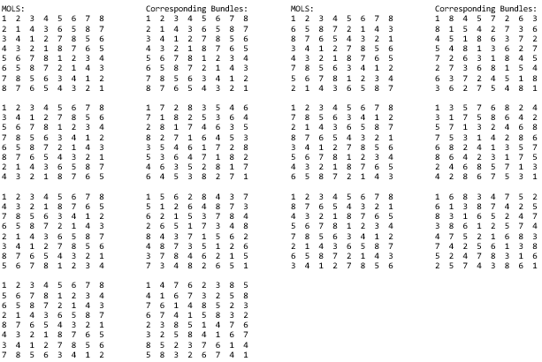
Generating (r-1) symmetric 1-intersecting bundles from GF(q)

Slide 102
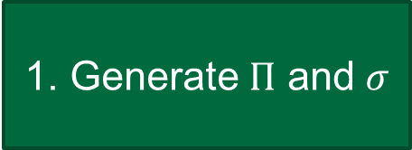
Summary
1. Generate $Π$ and $σ$
Bundles
MOLS

Slide 103
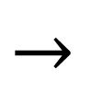
Summary
1. Generate $Π$ and $σ$
2. (r-2) 1-intersecting bundles
$$→$$
Bundles
MOLS

Slide 104
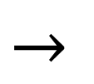
Summary
1. Generate $Π$ and $σ$
2. (r-2) 1-intersecting bundles
3. (r-2) MOLS
$$→$$
$$→$$
Bundles
MOLS

Slide 105

Summary
1. Generate $Π$ and $σ$
2. (r-2) 1-intersecting bundles
3. (r-2) MOLS
$$→$$
$$→$$
$$→$$
4. (r-2) reduced MOLS
Bundles
MOLS

Slide 106
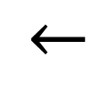
Summary
1. Generate $Π$ and $σ$
2. (r-2) 1-intersecting bundles
3. (r-2) MOLS
$$→$$
$$→$$
$$→$$
5. (r-2) 1-intersecting diagonal bundles
4. (r-2) reduced MOLS
$$→$$
Bundles
MOLS

Slide 107
Construction for (r-1) 1-intersecting bundles
1 2 3 4 5 6 7 8 9
7 8 9 1 2 3 4 5 6
4 5 6 7 8 9 1 2 3
6 4 5 9 7 8 3 1 2
3 1 2 6 4 5 9 7 8
9 7 8 3 1 2 6 4 5
8 9 7 2 3 1 5 6 4
5 6 4 8 9 7 2 3 1
2 3 1 5 6 4 8 9 7

Slide 108
Construction for (r-1) 1-intersecting bundles
1 2 3 4 5 6 7 8 9
7 8 9 1 2 3 4 5 6
4 5 6 7 8 9 1 2 3
6 4 5 9 7 8 3 1 2
3 1 2 6 4 5 9 7 8
9 7 8 3 1 2 6 4 5
8 9 7 2 3 1 5 6 4
5 6 4 8 9 7 2 3 1
2 3 1 5 6 4 8 9 7

Slide 109
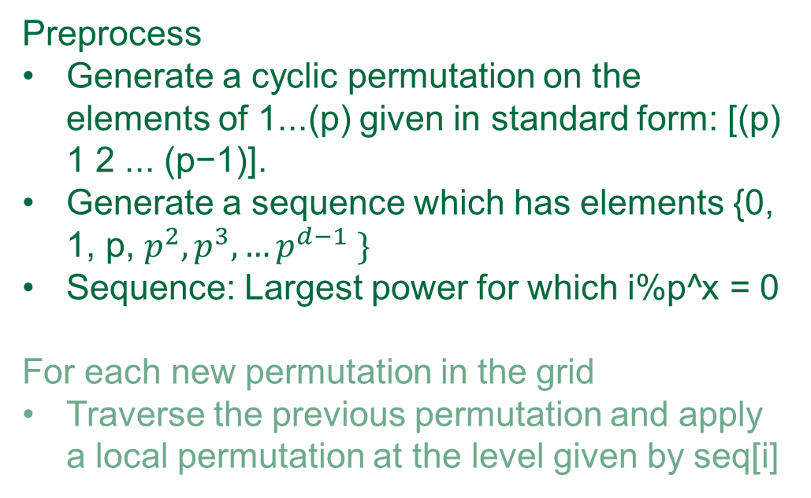
Construction for (r-1) 1-intersecting bundles
Preprocess
Generate a cyclic permutation on the elements of 1...(p) given in standard form: [(p) 1 2 ... (p−1)].
Generate a sequence which has elements {0, 1, p, $p^{2},p^{3},…p^{d−1} \}$
Sequence: Largest power for which i%p^x = 0
For each new permutation in the grid
Traverse the previous permutation and apply a local permutation at the level given by seq[i]

Slide 110

Construction for (r-1) 1-intersecting bundles
Preprocess
Generate a cyclic permutation on the elements of 1...(p) given in standard form: [(p) 1 2 ... (p−1)].
Generate a sequence which has elements {0, 1, p, $p^{2},p^{3},…p^{d−1} \}$
Sequence: Largest power for which i%p^x = 0
For each new permutation in the grid
Traverse the previous permutation and apply a local permutation at the level given by seq[i]

Slide 111


When does it work?
The construction outlined does not succeed for all prime powers.
Empirically, works for:
$2^{2}$
$2^{3}$
$2^{5}$
$2^{6}$
$2^{10}$
$3^{2}$
$3^{3}$
$3^{5}$
$3^{6}$

Slide 112
When does it work?
The construction outlined does not succeed for all prime powers.
Empirically, works for:
$2^{2}$
$2^{3}$
$2^{5}$
$2^{6}$
$2^{10}$
$3^{2}$
$3^{3}$
$3^{5}$
$3^{6}$
Next steps: prove why construction works in specific cases

Slide 113
Conclusions
Algorithmic Approach to k-intersecting vertex cover
Mathematical findings for 1-intersecting graphs
Novel generative algorithm for maximum sized 1-intersecting graph and MOLS

Slide 114


Conclusions
Algorithmic Approach to k-intersecting vertex cover
Mathematical findings for 1-intersecting graphs
Novel generative algorithm for maximum sized 1-intersecting graph and MOLS
NP-complete $→ O(V+E)$time

Slide 115
Conclusions
Algorithmic Approach to k-intersecting vertex cover
Mathematical findings for 1-intersecting graphs
Novel generative algorithm for maximum sized 1-intersecting graph and MOLS
NP-complete $→ O(V+E)$time

Slide 116

Conclusions
Algorithmic Approach to k-intersecting vertex cover
Mathematical findings for 1-intersecting graphs
Novel generative algorithm for maximum sized 1-intersecting graph and MOLS
NP-complete $→ O(V+E)$time
Bound on max degree: ${max⁡(d}_{v})=\left(r−1\right)$
Bound on edges: $m≤{\left(r−1\right)}^{2}$
Tightness condition: $m={\left(r−1\right)}^{2}$ $↔r−1=p^{d}$

Slide 117
Conclusions
Algorithmic Approach to k-intersecting vertex cover
Mathematical findings for 1-intersecting graphs
Novel generative algorithm for maximum sized 1-intersecting graph and MOLS
NP-complete $→ O(V+E)$time
Bound on max degree: ${max⁡(d}_{v})=\left(r−1\right)$
Bound on edges: $m≤{\left(r−1\right)}^{2}$
Tightness condition: $m={\left(r−1\right)}^{2}$ $↔r−1=p^{d}$

Slide 118

Conclusions
Algorithmic Approach to k-intersecting vertex cover
Mathematical findings for 1-intersecting graphs
Novel generative algorithm for maximum sized 1-intersecting graph and MOLS
NP-complete $→ O(V+E)$time
Bound on max degree: ${max⁡(d}_{v})=\left(r−1\right)$
Bound on edges: $m≤{\left(r−1\right)}^{2}$
Tightness condition: $m={\left(r−1\right)}^{2}$ $↔r−1=p^{d}$

Slide 119
Thank you
My advisor, Deeparnab Chakrabarty
Supportive faculty, Peter Winkler
My support network
My family

